Slide 1
Statistics and Probability basics for Data Analysis
Dr. Kailash Shaw

Slide 2
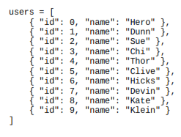
What is data science
Statistics refers to the mathematics and techniques with which we understand data
Facebook asks you to list your hometown and your current location, ostensibly to make it easier for your friends to find and connect with you. But it also analyzes these locations to identify global migration patterns and where the fanbases of different football teams live.
As a large retailer, Target tracks your purchases and interactions, both online and in-store. And it uses the data to predictively model which of its customers are pregnant, to better market baby-related purchases to them.
In 2012, the Obama campaign employed dozens of data scientists who data-mined and experimented their way to identifying voters who needed extra attention, choosing optimal donor-specific fundraising appeals and programs, and focusing get-out-the-vote efforts where they were most likely to be useful.

Slide 3

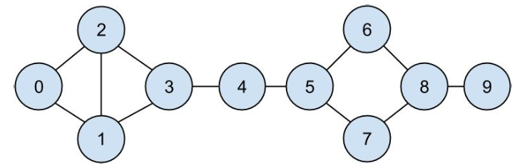
Motivating Hypothetical: DataSciencester
Suppose You have a dataset looks like
“friendship” data

Slide 4

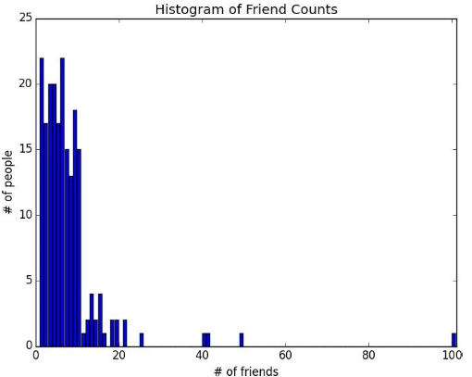
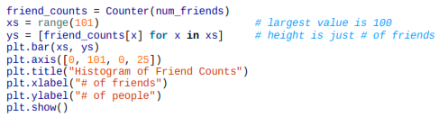
Describing a Single Set of Data
How many friends your members have for prev data set?
For a small enough data set this might even be the best description. But for a larger data set, this is unwieldy and probably opaque. (Imagine staring at a list of 1 million numbers.) For that reason we use statistics to distill and communicate relevant features of our data. As a first approach you put the friend counts into a histogram using Counter and plt.bar()

Slide 5
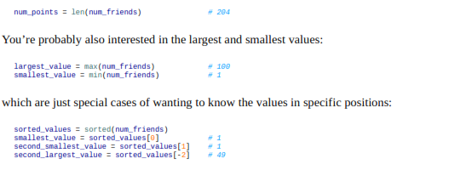

Describing a Single Set of Data (Cont..)

Slide 6
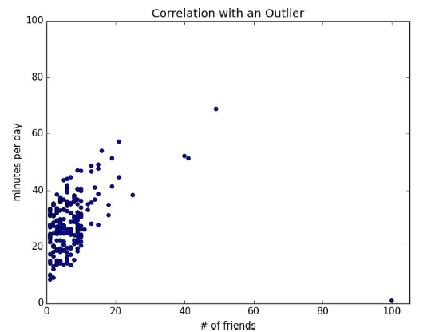

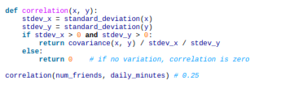
Correlation

Slide 7

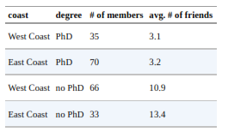
Simpson’s Paradox
One not uncommon surprise when analyzing data is Simpson’s Paradox, in which correlations can be misleading when confounding variables are ignored.
For example, imagine that you can identify all of your members as either East Coast data scientists or West Coast data scientists. You decide to examine which coast’s data scientists are friendlier:
When playing with the data you discover something very strange. If you only look at people with PhDs, the East Coast data scientists have more friends on average. And if you only look at people without PhDs, the East Coast data scientists also have more friends on average

Slide 8


Some Other Correlational Caveats
A correlation of zero indicates that there is no linear relationship between the two variables. However, there may be other sorts of relationships. For example, if:
then x and y have zero correlation. But they certainly have a relationship — each element of y equals the absolute value of the corresponding element of x. What they don’t have is a relationship in which knowing how x_i compares to mean(x) gives us information about how y_i compares to mean(y). That is the sort of relationship that correlation looks for.
In addition, correlation tells you nothing about how large the relationship is. The variables: are perfectly correlated, but (depending on what you’re measuring) it’s quite possible that this relationship isn’t all that interesting.

Slide 9
Correlation and Causation
You have probably heard at some point that “correlation is not causation,” most likely by someone looking at data that posed a challenge to parts of his worldview that he was reluctant to question. Nonetheless, this is an important point — if x and y are strongly correlated, that might mean that x causes y, that y causes x, that each causes the other, that some third factor causes both, or it might mean nothing.
Consider the relationship between num_friends and daily_minutes. It’s possible that having more friends on the site causes DataSciencester users to spend more time on the site. This might be the case if each friend posts a certain amount of content each day, which means that the more friends you have, the more time it takes to stay current with their updates.
However, it’s also possible that the more time you spend arguing in the DataSciencester forums, the more you encounter and befriend like-minded people. That is, spending more time on the site causes users to have more friends.
A third possibility is that the users who are most passionate about data science spend more time on the site (because they find it more interesting) and more actively collect data science friends (because they don’t want to associate with anyone else).

Slide 10
Probability
It is hard to do data science without some sort of understanding of probability and its mathematics
For our purposes you should think of probability as a way of quantifying the uncertainty associated with events chosen from a some universe of events. Rather than getting technical about what these terms mean, think of rolling a die. The universe consists of all possible outcomes. And any subset of these outcomes is an event; for example, “the die rolls a one” or “the die rolls an even number.”
Notationally, we write
to mean “the probability of the event E.”
We’ll use probability theory to build models.
We’ll use probability theory to evaluate models.
We’ll use probability theory all over the place.

Slide 11

Dependence and Independence
Roughly speaking, we say that two events E and F are dependent if knowing something about whether E happens gives us information about whether F happens (and vice versa). Otherwise they are independent.
For instance, if we flip a fair coin twice, knowing whether the first flip is Heads gives us no information about whether the second flip is Heads. These events are independent.
On the other hand, knowing whether the first flip is Heads certainly gives us information about whether both flips are Tails. (If the first flip is Heads, then definitely it’s not the case that both flips are Tails.) These two events are dependent.
Mathematically, we say that two events E and F are independent if the probability that they both happen is the product of the probabilities that each one happens:
In the example above, the probability of “first flip Heads” is 1/2, and the probability of “both flips Tails” is 1/4, but the probability of “first flip Heads and both flips Tails” is 0.

Slide 12


Conditional Probability
When two events E and F are independent, then by definition we have:
If they are not necessarily independent (and if the probability of F is not zero), then we define the probability of E “conditional on F” as:
You should think of this as the probability that E happens, given that we know that F happens. We often rewrite this as:
When E and F are independent, you can check that this gives:
which is the mathematical way of expressing that knowing F occurred gives us no additional information about whether E occurred.

Slide 13
Bayes’s Theorem
One of the data scientist’s best friends is Bayes’s Theorem, which is a way of “reversing” conditional probabilities. Let’s say we need to know the probability of some event E conditional on some other event F occurring. But we only have information about the probability of F conditional on E occurring. Using the definition of conditional probability twice tells us that:
The event F can be split into the two mutually exclusive events “F and E” and “F and not E.” If we write
fo “not E” (i.e., “E doesn’t happen”), then:
so that:
which is how Bayes’s Theorem is often stated.

Slide 14

Imagine a certain disease that affects 1 in every 10,000 people. And imagine that there is a test for this disease that gives the correct result (“diseased” if you have the disease, “nondiseased” if you don’t) 99% of the time.
What does a positive test mean? Let’s use T for the event “your test is positive” and D for the event “you have the disease.” Then Bayes’s Theorem says that the probability that you have the disease, conditional on testing positive, is:
Here we know that
the probability that someone with the disease tests positive, is 0.99
, the probabiliy that any given person has the disease, is 1/10,000 = 0.0001.
, the probability that someone without the disease tests ositive, is 0.01. And
, the probability that any given person doesn’t have he disease, is 0.9999. If you substitute these numbers into Bayes’s Theorem you find
That is, less than 1% of the people who test positive actually have the disease

Slide 15
Random Variables
A random variable is a variable whose possible values have an associated probability distribution. A very simple random variable equals 1 if a coin flip turns up heads and 0 if the flip turns up tails. A more complicated one might measure the number of heads observed when flipping a coin 10 times or a value picked from range(10) where each number is equally likely.
The associated distribution gives the probabilities that the variable realizes each of its possible values. The coin flip variable equals 0 with probability 0.5 and 1 with probability
0.5. The range(10) variable has a distribution that assigns probability 0.1 to each of the numbers from 0 to 9.
We will sometimes talk about the expected value of a random variable, which is the average of its values weighted by their probabilities. The coin flip variable has an expected value of 1/2 (= 0 * 1/2 + 1 * 1/2), and the range(10) variable has an expected value of 4.5.
Random variables can be conditioned on events just as other events can. Going back to the two-child example from “Conditional Probability”, if X is the random variable
representing the number of girls, X equals 0 with probability 1/4, 1 with probability 1/2, and 2 with probability 1/4.
We can define a new random variable Y that gives the number of girls conditional on at least one of the children being a girl. Then Y equals 1 with probability 2/3 and 2 with probability 1/3. And a variable Z that’s the number of girls conditional on the older child being a girl equals 1 with probability 1/2 and 2 with probability 1/2.
For the most part, we will be using random variables implicitly in what we do without calling special attention to them. But if you look deeply you’ll see them.

Slide 16
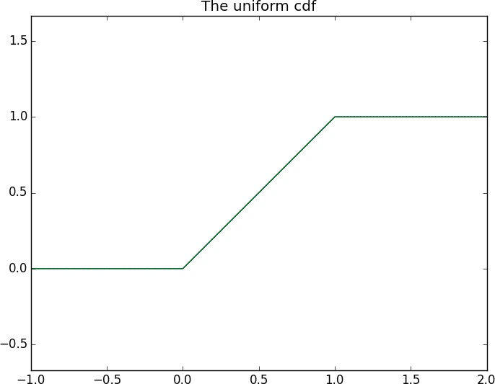
Continuous Distributions
discrete distribution — one that associates positive probability with discrete outcomes
For example, the uniform distribution puts equal weight on all the numbers between 0 and 1.
Because there are infinitely many numbers between 0 and 1, this means that the weight it assigns to individual points must necessarily be zero. For this reason, we represent a continuous distribution with a probability density function (pdf) such that the probability of seeing a value in a certain interval equals the integral of the density function over the interval.

Slide 17
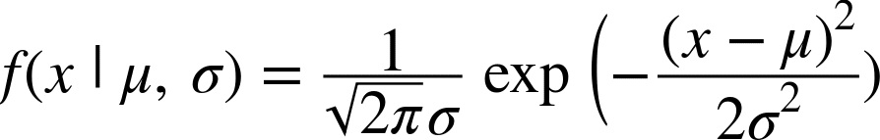
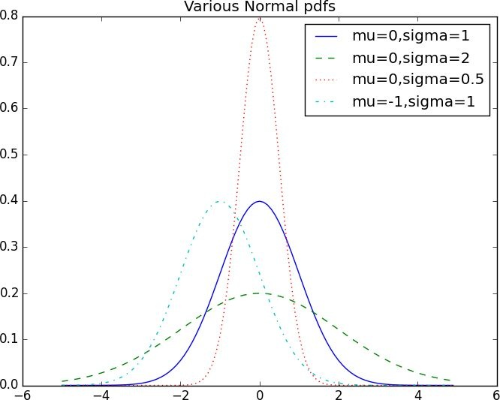
The Normal Distribution
The normal distribution is the king of distributions. It is the classic bell curv–shaped distribution and is completely determined by two parameters:

Slide 18

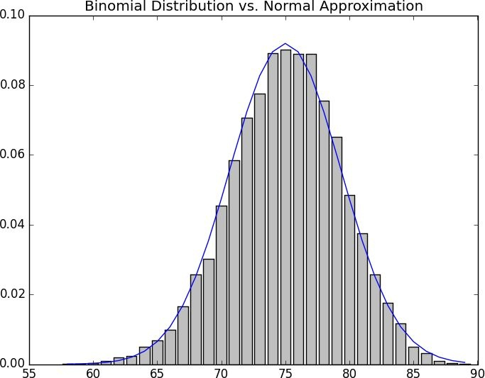
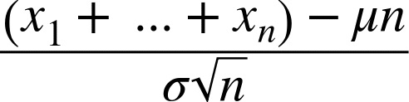
The Central Limit Theorem
One reason the normal distribution is so useful is the central limit theorem, which says (in essence) that a random variable defined as the average of a large number of independent and identically distributed random variables is itself approximately normally distributed.
are random variables with mean
In particular, if
and standard deviation , and if n is large, then:
is approximately normally distributed with mean and standard deviation
. Equivalently (but often more usefully),
is approximately normally distributed with mean 0 and standard deviation 1.

